Slide 1
IODVS Intra-Operation Dynamic Voltage Scaling
Daniel Moore
October 17th, 2014

Slide 2
About Me
ADMMicro / Gridpoint
Energy Management / Building Automation
Commercial sub-metering building loads (HVAC / Lighting / etc.)
Environmental / Lighting Control
Communicating thermostats / remote sensors
Elster
Utility Metering (Gas / Water / Electricity)
Measurement accuracy and data integrity are key!
Communication via 900MHz Mesh / 2.4GHz Zigbee / 2G/3G
NCSU
Working with Dr. Dean on low-power embedded systems
Mitigating performance loss due to power requirements … or at least quantifying them

Slide 3
Agenda
Peripherals in Embedded Systems
Energy Management: PEGMA
Current Research and Objectives
Methods and Results
Conclusions and Implications

Slide 4
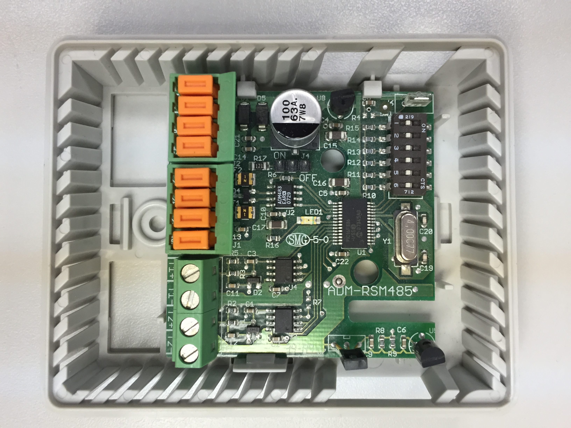
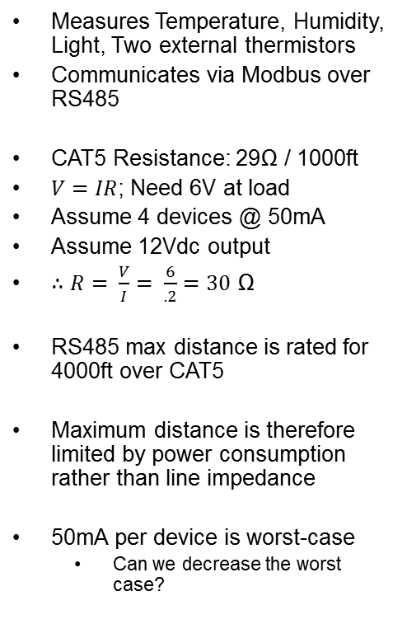
Motivating Example: Remote Sensor Module
Measures Temperature, Humidity, Light, Two external thermistors
Communicates via Modbus over RS485
CAT5 Resistance: 29Ω / 1000ft
$V=IR$; Need 6V at load
Assume 4 devices @ 50mA
Assume 12Vdc output
$∴R= \frac{V}{I}= \frac{6}{.2}=30$ Ω
RS485 max distance is rated for 4000ft over CAT5
Maximum distance is therefore limited by power consumption rather than line impedance
50mA per device is worst-case
Can we decrease the worst case?

Slide 5
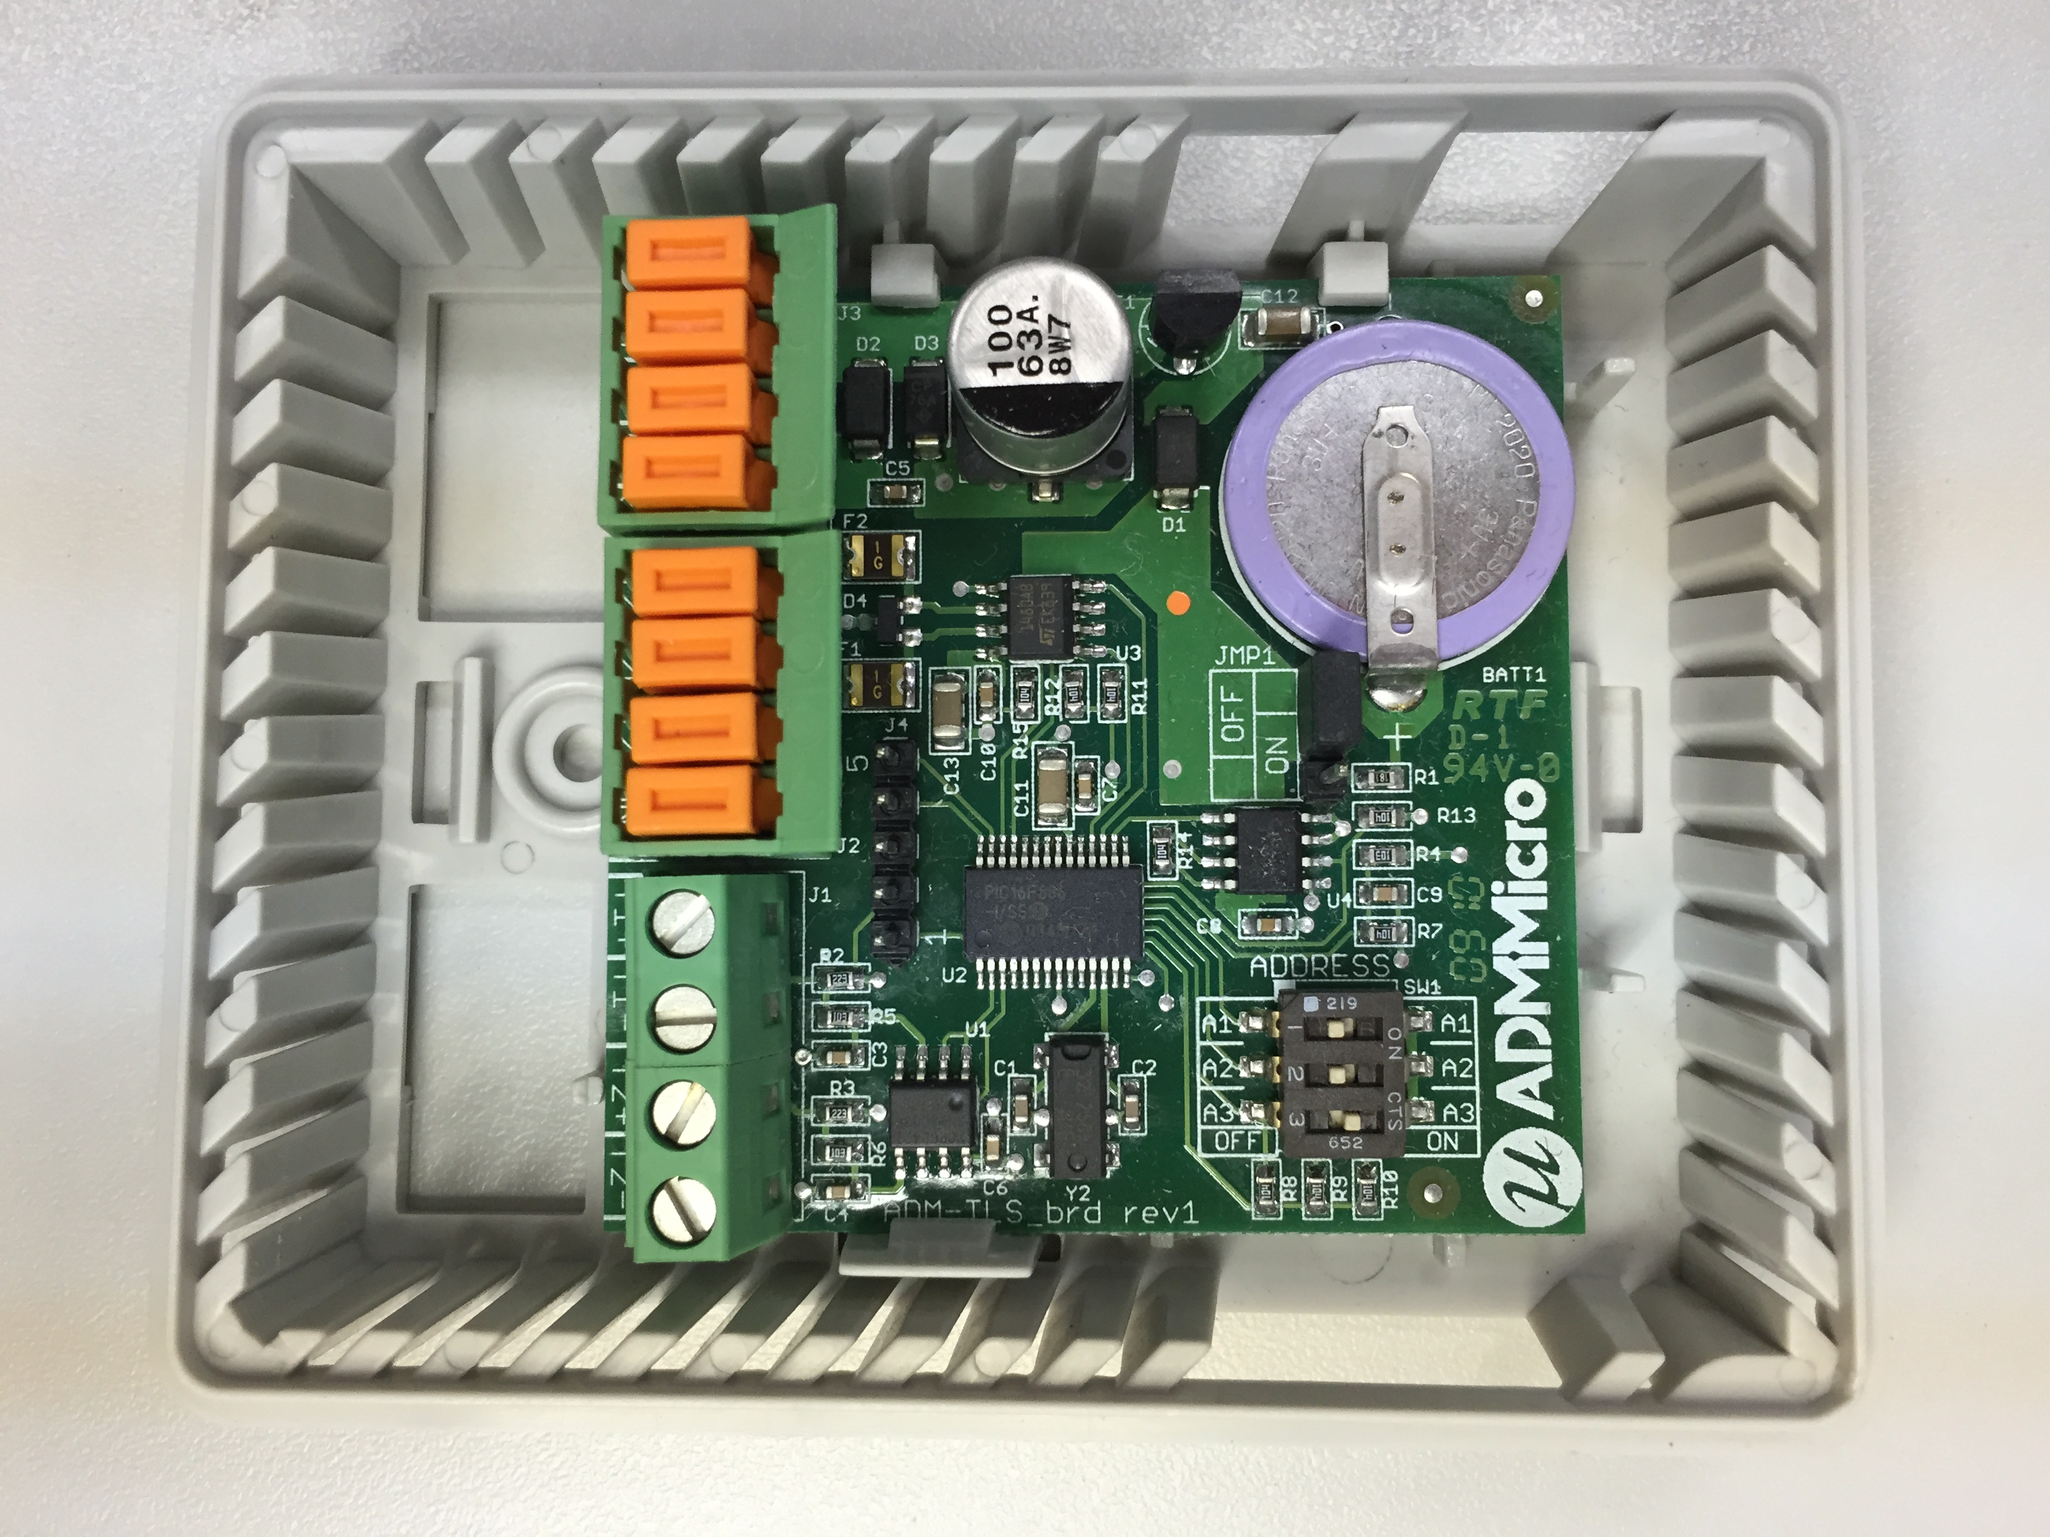
Motivating Example: Logging Sensor
Primarily used for logging temperatures in freezers over the course of a power failure
The temperature profile determines if food is safe or must be thrown out
Upon detecting a loss of power:
MCU goes into sleep mode
Wakes up every 1 second
Takes two external temperature measurements
Logs them to EEPROM
Goes back to sleep
EEPROM is necessary in case the battery depletes before power is restored
The write to EEPROM dominates the operational energy consumption

Slide 6
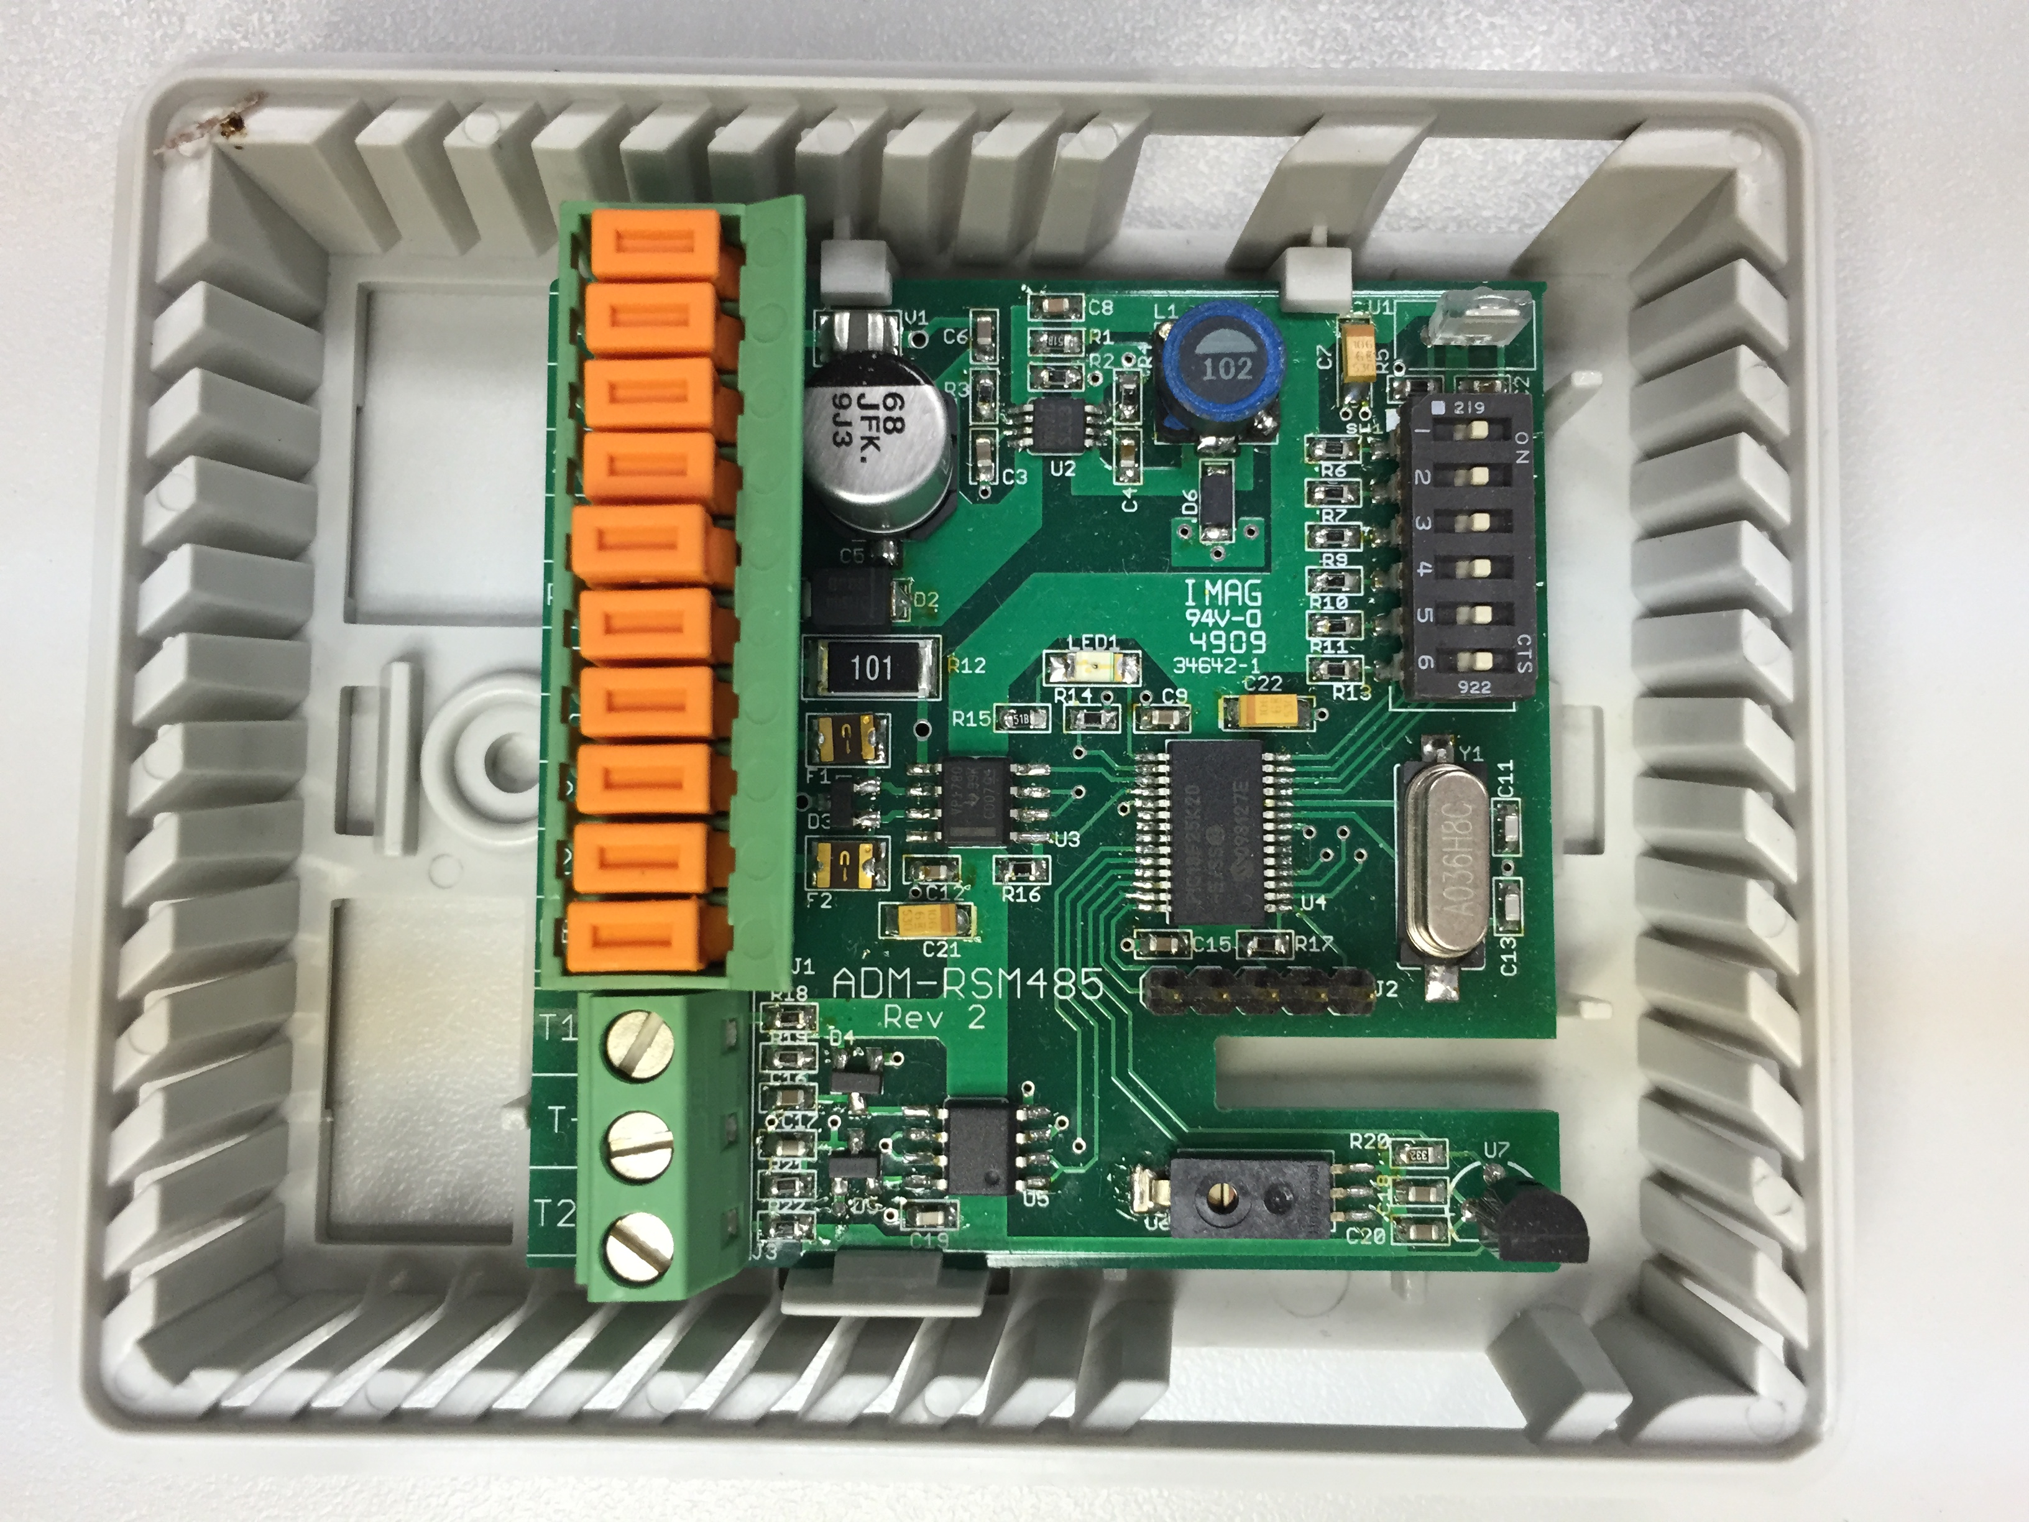
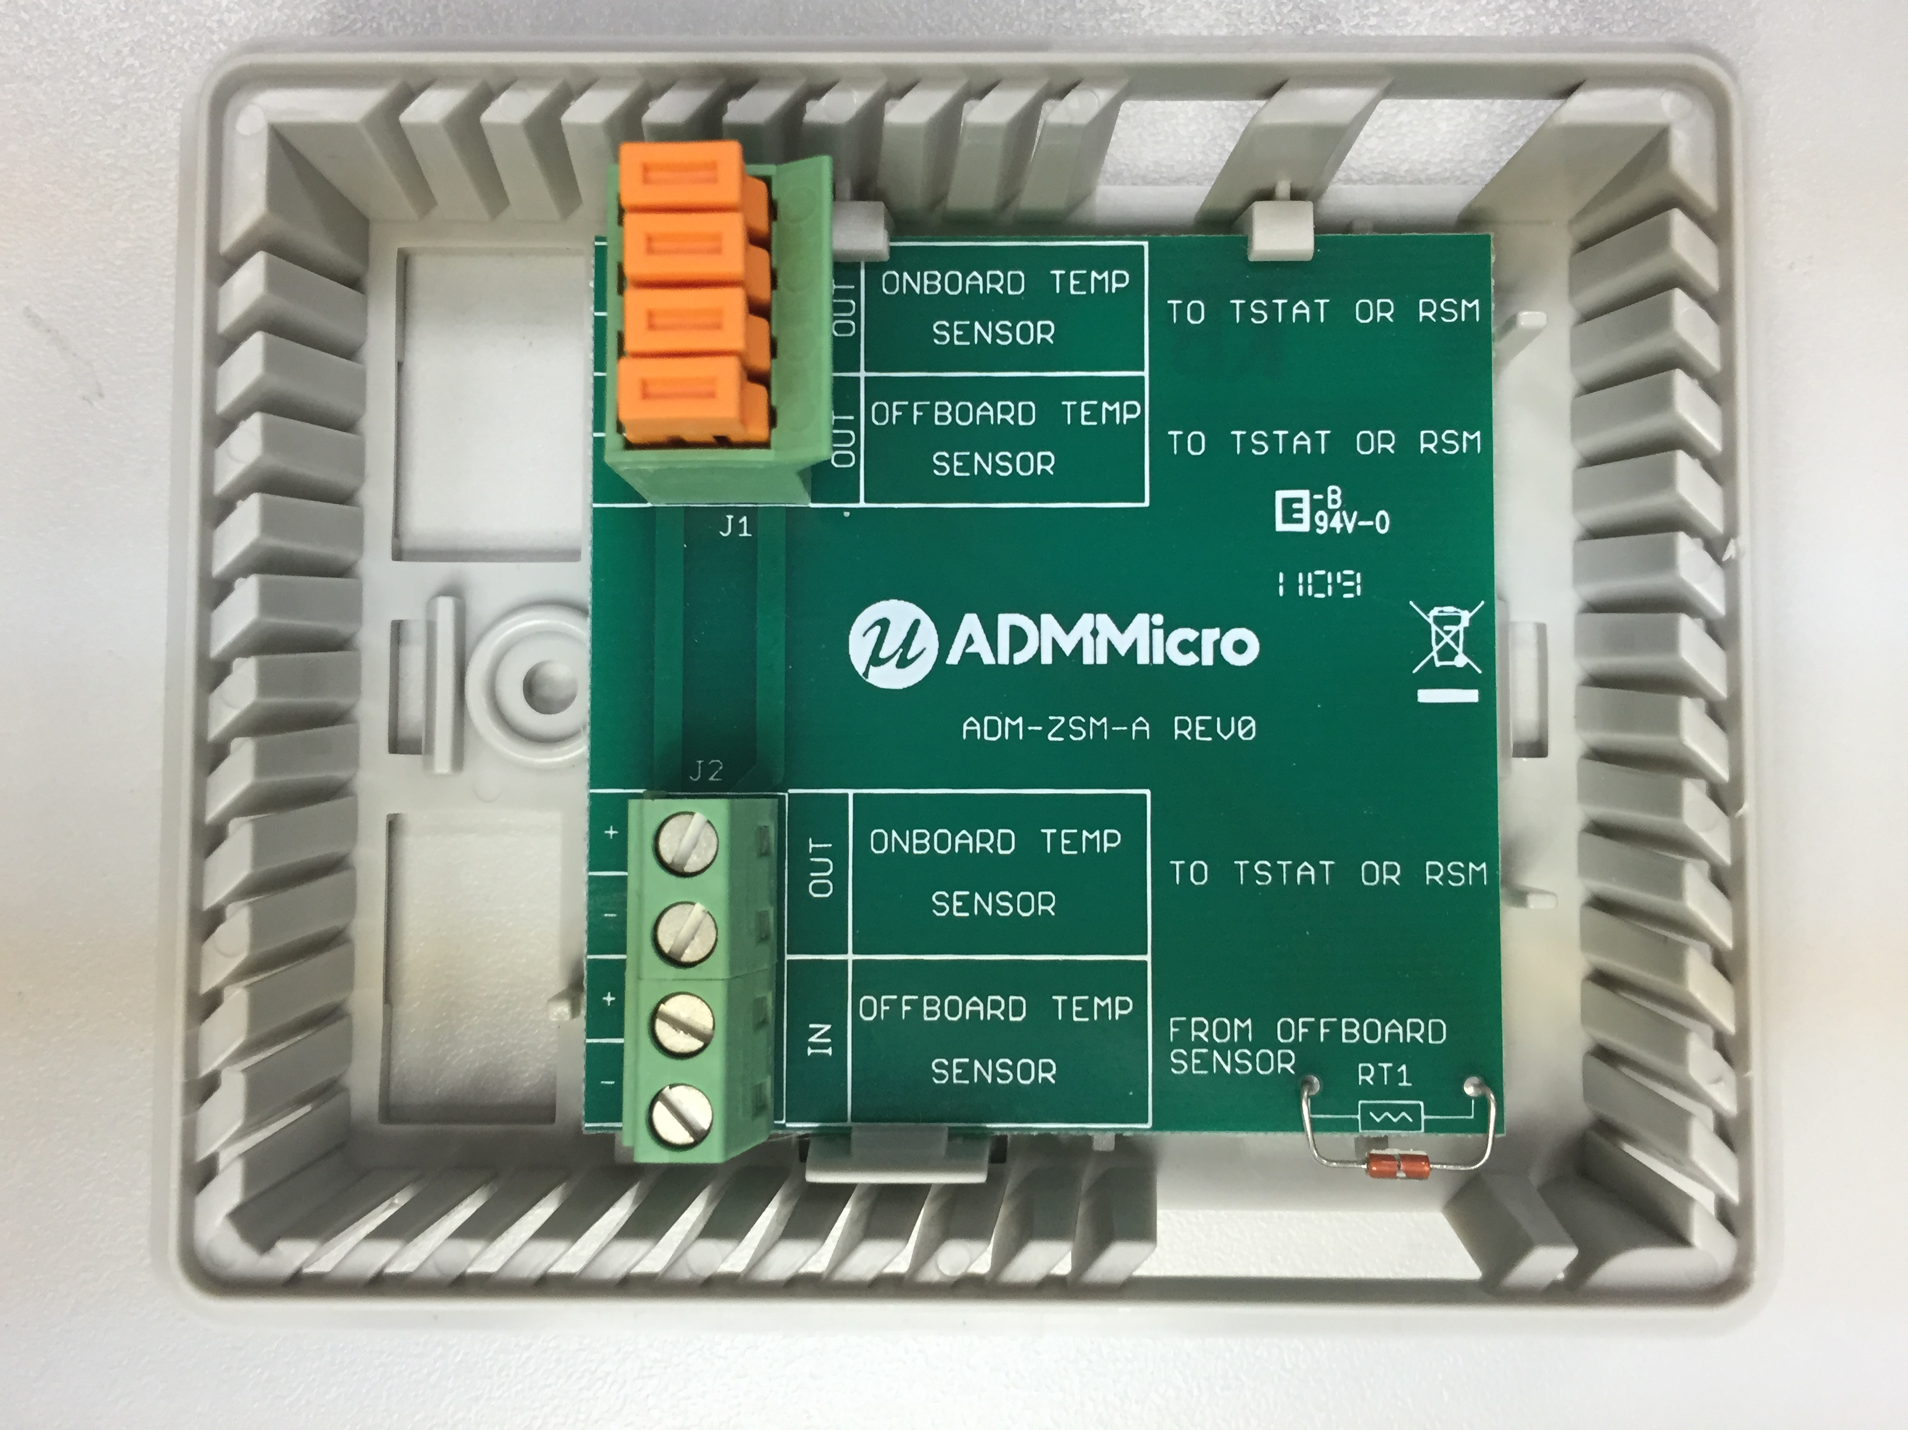
Remote Sensor Module Rev2
Voltage drop became such an issue that the RSM was redesigned to accept 24Vac and use less power (at increased cost)
Zone Sensor Module
An example of one of the external thermistors connected to RSMs and TLSs

Slide 7
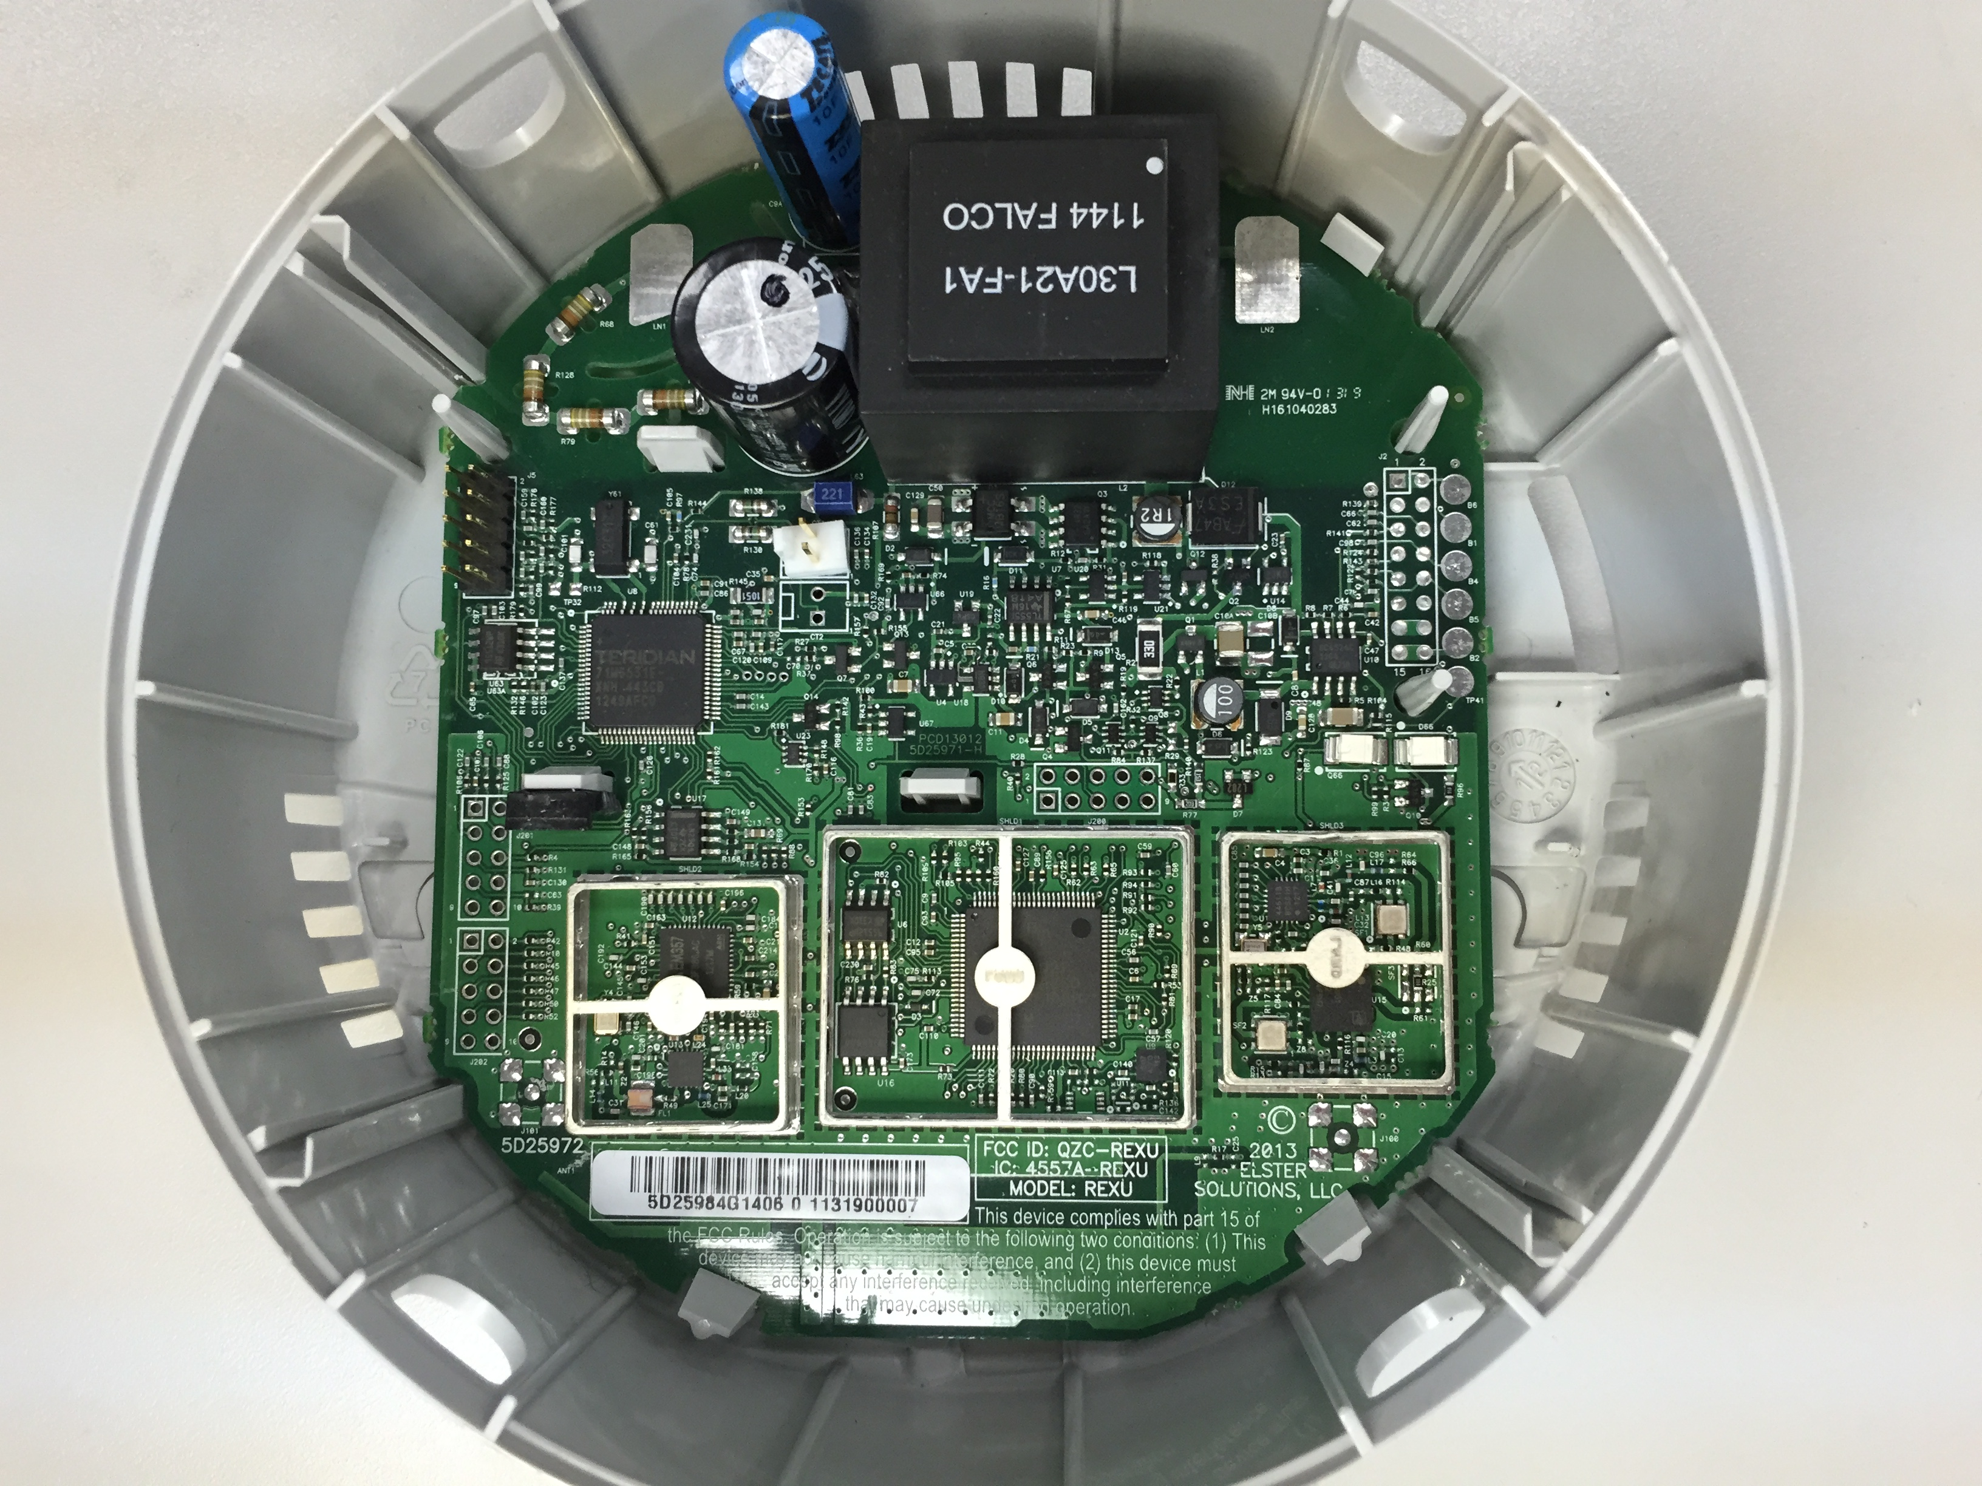
Motivating Example: Rex Electricity Meter
Electrolytic capacitor continues to run the meter for ~200ms after a power failure occurs
Maxim 8051 Metrology Core
Uses EEPROM
Energy Usage
Demand Intervals
Profile Information
NV-RAM
TI Cortex-M3 Core
Uses Serial flash
Network routing data
Encryption Keys?
Radio Interface
Ember Zigbee
Radio Interface

Slide 8
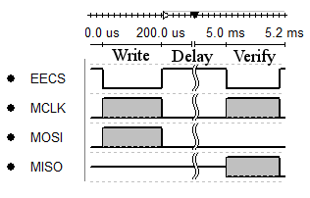
NV-RAM Functionality
EEPROM has a limited write-cycle count (~1,000,000)
Serial flash is typically ~100,000
Some values need to be updated constantly and preserved across power failures
Typically indexes into logs
Energy accumulations
Status information
Solution: Use RAM, and use an interrupt to back it up as power fail occurs
Requires a capacitor capable of holding Vdd while backup is in progress
Actual communication is only 7.7% of the total write time. The other 92.3% is a mandatory wait period imposed by the chip ‘page-write time’
How can we decrease the energy consumed during the page write time?

Slide 9
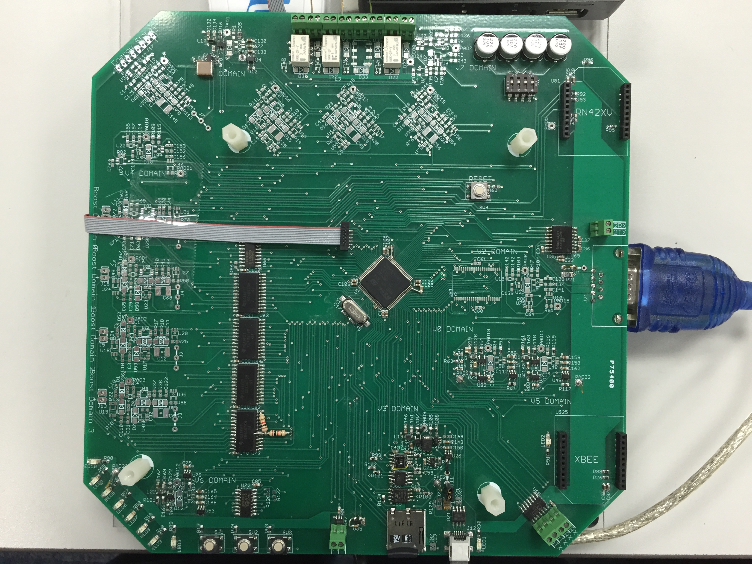
How: PEGMA
Peripheral Energy Generation Measurement and Allocation
4x + 1 input (boost) SMPS
3x output boost SMPS
8 independently adjustable buck SMPS domains
MCU: STM32F205
2x 10-bit DAC
3x 12-bit ADC (2 MSPS per)
Analog
SRAM
SPI Peripherals
EEPROM
Serial Flash
Temp/Humidity Sensor
Micro-SD Card
Battery Charging
Communications
RS232
RS485
Bluetooth
Zigbee
LEDs / Pushbuttons
Relays
I/O Voltage and Current Measurement on each SMPS
Effectively sub-metering the board
Allows us to measure efficiency

Slide 10
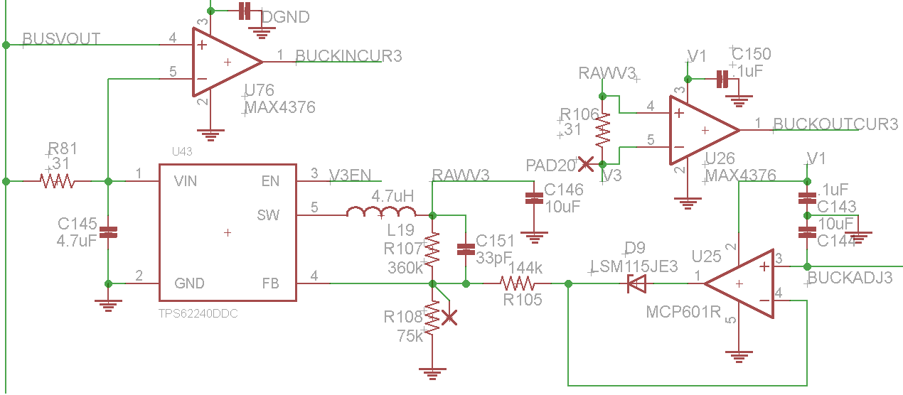
Adjustable SMPS
TPS62240 efficient at light loads
~80% at 1mA
I/O current measured by MAX4376
“High Side” sense resistor is used, differential across is multiplied by the amplifier gain
2MHz GBP, G = 20
Output Voltage modulated by current into the FB pin
Therefore D9 allows the SMPS to enter a ‘default’ state
And U25 / R105 allow FB current to be modulated by BUCKADJ3
C144 holds the adjustment voltage so that other domains can be ‘refreshed’ in round robin fashion

Slide 11
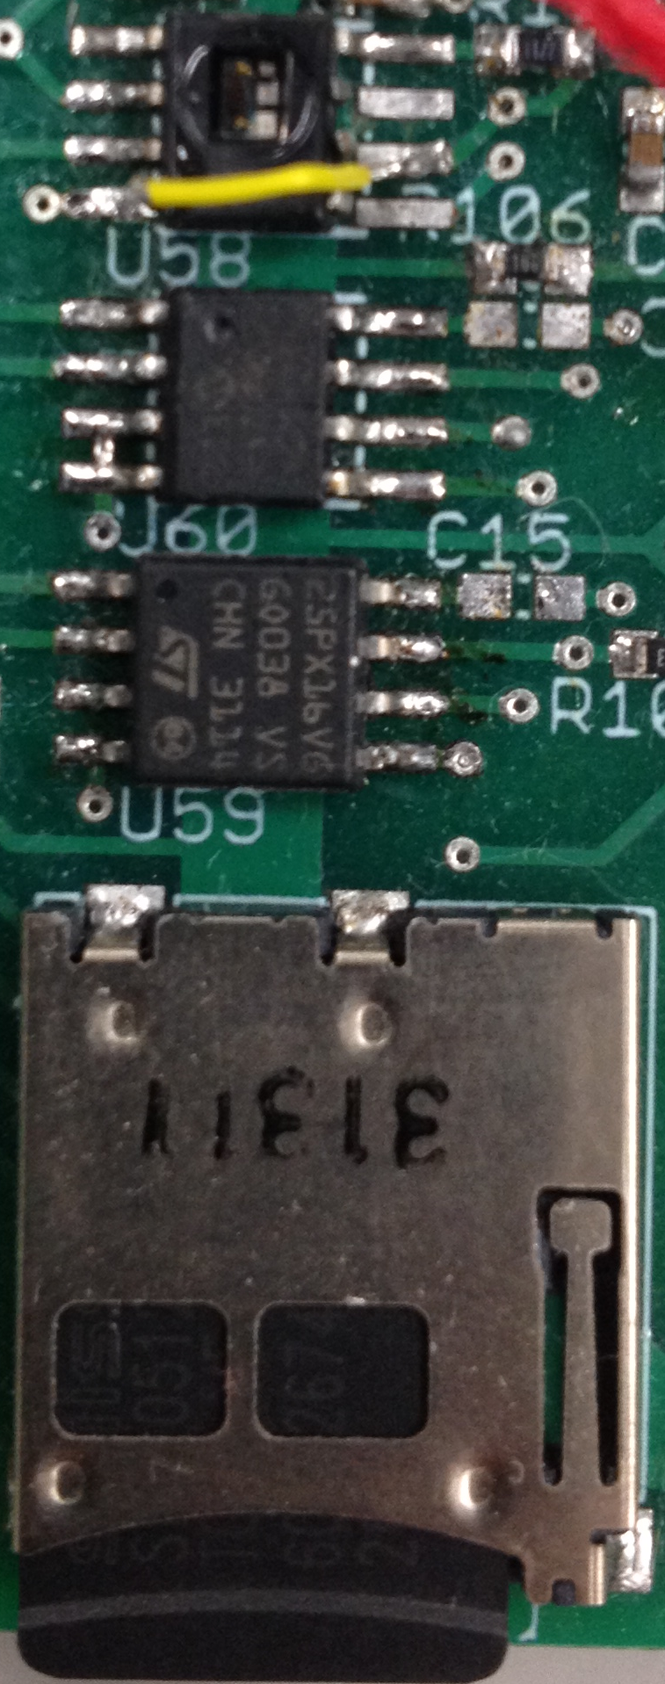
Peripheral Domain
Honeywell HIH6130 (I²C) Temperature/Humidity Sensor
Vmax: 5.5V
Vmin: 2.3V
Microchip 25AA512 EEPROM
Vmax: 5.5V (20MHz)
Vmin: 1.8V (2MHz)
Numonyx M25PX16 (16Mbit)
Vmax: 3.6V (50MHz)
Vmin: 2.3V (25MHz)
SPI Mode SD Cards
Lexar SDSC: 1.0GB
Sandisk: SDSC 1.0GB
Swissbit: SDSC 512MB
Kingston: SDSC 2.0GB
Vmax: 3.6V
Vmin: 2.7V (operating)
Vmin: 2.0V (Idle/Read)

Slide 12
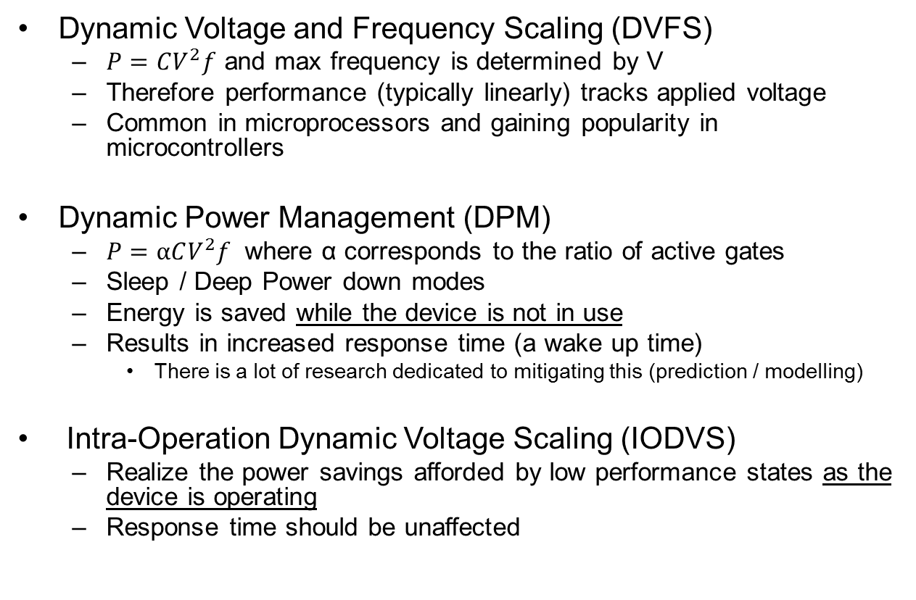
Current Research / Objectives
Dynamic Voltage and Frequency Scaling (DVFS)
$P=CV^{2}f$ and max frequency is determined by V
Therefore performance (typically linearly) tracks applied voltage
Common in microprocessors and gaining popularity in microcontrollers
Dynamic Power Management (DPM)
$P=αCV^{2}f$ where α corresponds to the ratio of active gates
Sleep / Deep Power down modes
Energy is saved while the device is not in use
Results in increased response time (a wake up time)
There is a lot of research dedicated to mitigating this (prediction / modelling)
Intra-Operation Dynamic Voltage Scaling (IODVS)
Realize the power savings afforded by low performance states as the device is operating
Response time should be unaffected

Slide 13
Assumptions and Test Requirements
Assumptions
Measurements are for the set of peripherals (not individually metered)
Only Datasheet specifications form the peripheral power profile
Matched signaling voltages between MCU and peripheral
Test setup
Tests use random data and addresses for memory devices
Average 2048 test results
Should be deterministic as possible
Use as high a sampling frequency as the operation will allow
Buffer size is 10240 samples * 4 channels including state
Therefore a 10ms test can use about a 1us sample rate

Slide 14
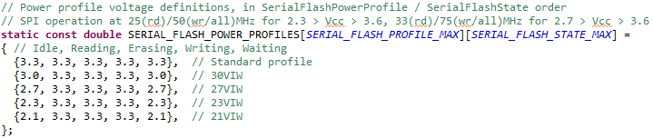
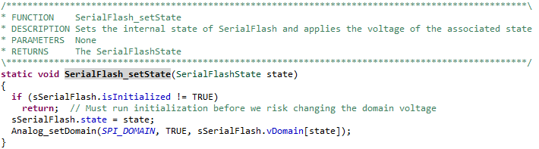
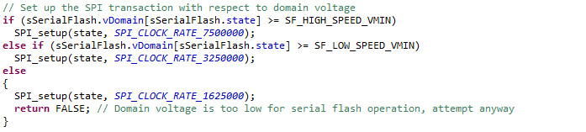
Peripheral Power Profiles
Each device driver contains a lookup table of state-voltage pairs
As the device enters a new state, the voltage is changed to correspond with the requirements of that state
Setup the onboard peripheral to correspond with the ability of the device
This was generally abandoned because it was found that the MCU could end up charging the domain via the communicating port pins
But it does apply to I²C devices

Slide 15
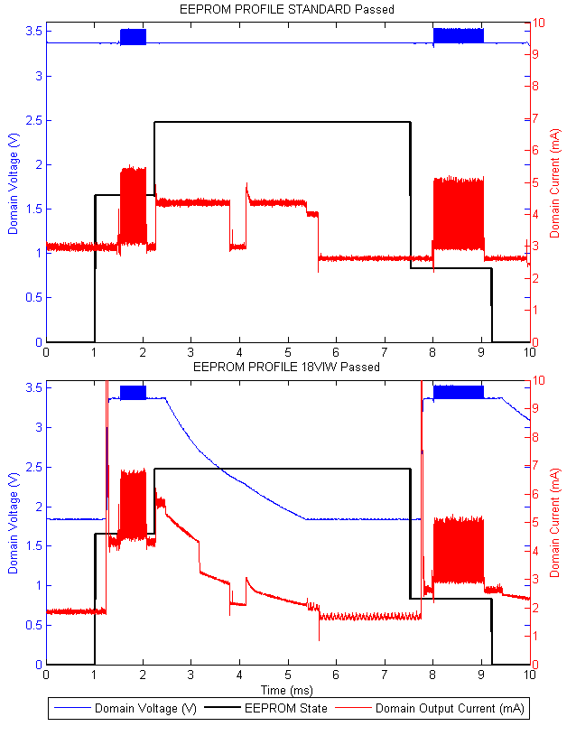
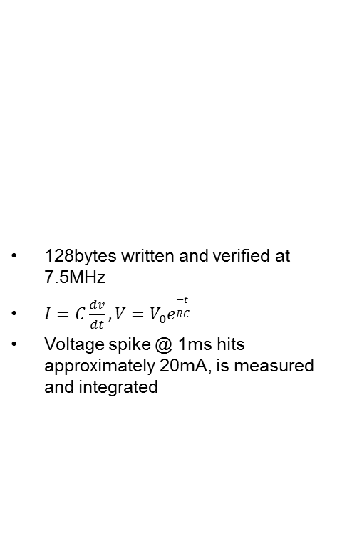
Microchip 25AA512 EEPROM
128bytes written and verified at 7.5MHz
$I=C\frac{dv}{dt}, V=V_{0}e^{\frac{−t}{RC}}$
Voltage spike @ 1ms hits approximately 20mA, is measured and integrated
State | Static (uJ) | IODVS (uJ) | Delta
Idle | 10.24 | 3.49 | -65.91%
Write | 13.79 | 17.85 | 29.47%
Wait | 64.59 | 33.71 | -47.80%
Verify | 17.58 | 17.40 | -1.02%
Idle | 8.81 | 7.96 | -9.57%
Total | 115.02 | 80.43 | -30.07%

Slide 16
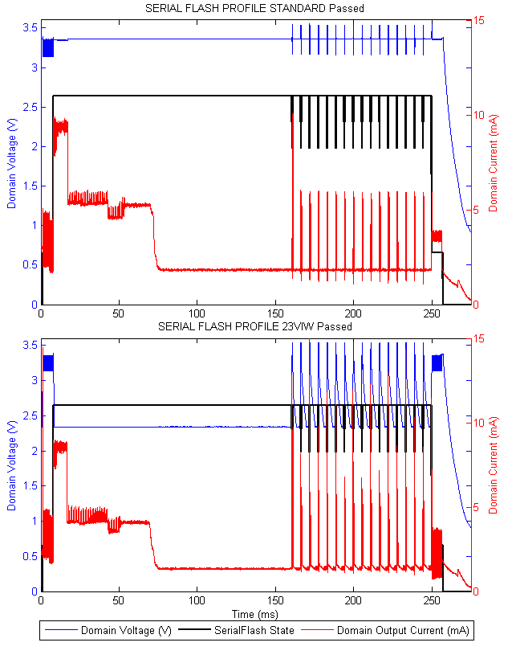
Numonyx 25PX16 Serial Flash
Read 4K subsector, modify 128B within the (cached) subsector
Rewrite the subsector 1 page (256B) at a time
Read the 4K subsector, verify against the cached copy
*Accumulated Write and Wait States
State | Static (uJ) | IODVS (uJ) | Delta
Idle | 10.73 | 5.63 | -47.58%
Read | 71.51 | 72.36 | 1.19%
Erase | 2.47 | 2.47 | -0.13%
Write* | 89.48 | 99.16 | 10.82%
Wait* | 574.84 | 365.75 | -36.37%
Verify | 83.78 | 52.77 | -37.02%
Idle | 38.92 | 38.20 | -1.85%
Total | 2666.18 | 1614.57 | -39.44%

Slide 17
Micro-SD Card (SPI Mode) Write Operation
Power Up
(1ms < t < 35ms)
Initialize
(10ms < t < 1000ms)
Enter / Exit Power Down*
Write Command
(~1ms)
Idle
Poll
(0 < t < 250ms)
Read (Verify)
(~1ms)
Protocol is polling based, making it difficult to conform to our assumption that all communication take place at the same voltage … but not impossible

Slide 18
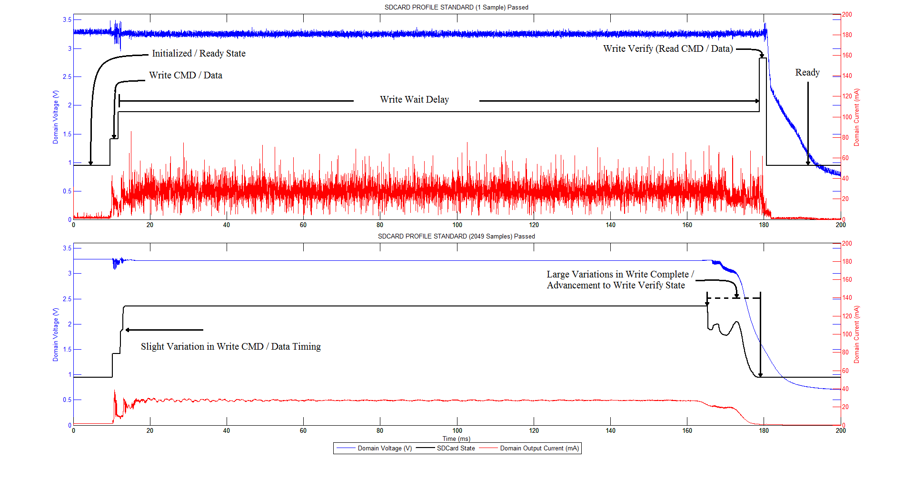
SD-Card Timing Variations
These tests tend to be non-deterministic because of the SD-Card protocol and onboard MMU.
Some operations complete near the 160ms mark, some near the 180ms mark.
Optimizing the wake-up-and-poll time is under further research

Slide 19
Sandisk Micro-SD Card
Lexar Micro-SD Card
Energy Usage | Static (uJ) | IODVS (uJ) | Delta
Idle | 157.07 | 138.95 | -11.54%
Writing | 26.48 | 26.23 | -0.93%
Waiting | 14021.97 | 10126.95 | -27.78%
Verify | 89.86 | 91.88 | 2.25%
Total | 14295.38 | 10384.02 | -27.36%
Energy Usage | Static (uJ) | IODVS (uJ) | Delta
Idle | 124.09 | 102.41 | -17.47%
Writing | 34.52 | 34.42 | -0.28%
Waiting | 16608.43 | 12558.83 | -24.38%
Verify | 39.45 | 56.87 | 44.17%
Total | 16806.48 | 12752.54 | -24.12%

Slide 20
SwissBit Micro-SD Card
Kingston Micro-SD Card
Energy Usage | Static (uJ) | IODVS (uJ) | Delta
Idle | 66.25 | 43.53 | -34.30%
Writing | 25.01 | 25.72 | 2.85%
Waiting | 3726.20 | 2839.78 | -23.79%
Verify | 74.58 | 72.59 | -2.67%
Total | 3892.04 | 2981.62 | -23.39%
Energy Usage | Static (uJ) | IODVS (uJ) | Delta
Idle | 24.63 | 16.89 | -31.40%
Writing | 89.74 | 91.45 | 1.90%
Waiting | 122.44 | 97.39 | -20.46%
Verify | 54.00 | 57.53 | 6.53%
Total | 290.81 | 263.26 | -9.47%

Slide 21
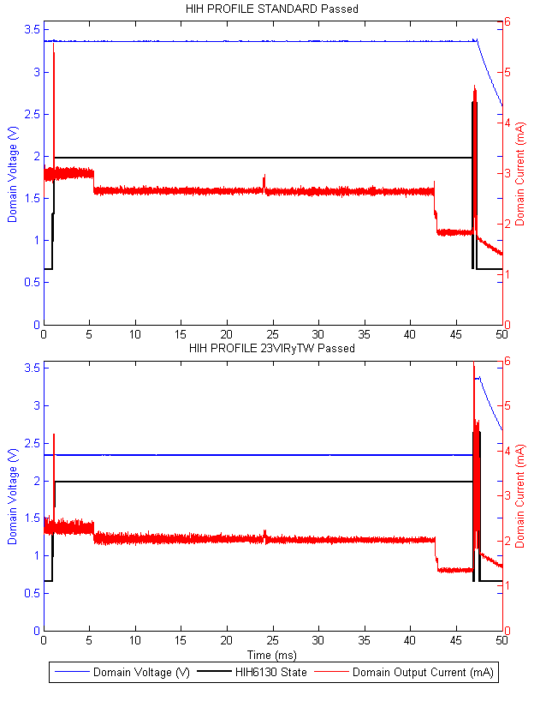
Honeywell HIH6130 Temperature / Humidity Sensor
I²C devices operate in open-collector mode. The bus is pulled to the device Vdd.
Therefore, only reading a response from the device requires matched voltages
Has the added benefit that high voltages increase I2C speed
Energy Usage | Static (uJ) | IODVS (uJ) | Delta
Idle | 10.277369 | 6.2822829 | 61.13%
Command | 1.6786557 | 1.0474309 | 62.40%
Waiting | 399.0716 | 245.89278 | 61.62%
Reading | 4.3045919 | 4.4171913 | 102.62%
Total | 415.33221 | 257.63969 | 62.03%

Slide 22
Comparison
Requirements
Benefits
Requires an adjustable regulator (SMPS realistically)
Adds cost
Potentially adds complexity
Requires some method of modulation
PWM, DAC, Digital Pot., etc.
Requires specific knowledge of peripheral operation
Second-Sourcing may be impacted
Voltage slack is decreased
Significant energy savings throughout the dominant periods of operation
May benefit cost
May yield better performance
RSM distance
Thermal impact of relays
Near-zero CPU impact
Near-zero performance impact
Driver retrofit isn’t complex
Regulator modulation can be as simple or as complex as required

Slide 23
Conclusions / Further Research
The application of IODVS is need-specific
We have used a DAC here because it gives us the greatest flexibility, other solutions are far less complex and less costly
You could just as easily use a MOSFET connected to the FB chain
The best voltages to use need to be researched before design
And with respect to EVERY device on the domain!
Further Research
Write-completion predictor for polling based protocols (SD in particular)
Cost model in terms of component reduction (NV-RAM electrolytic capacitor) vs component addition (SMPS modulation)
SMPS response time / efficiency
Thank you!

